Slide 1
CSE 11 Accelerated Intro to Programming Lecture 8
Greg Miranda, Spring 2021
This lecture is being recorded

Slide 2
Announcements
Quiz 8 due Friday @ 8am
PA2 due tonight @ 11:59pm
Survey 3 due Friday @ 11:59pm
PA0.5 Resubmission due Friday @ 11:59pm
Or see a tutor during lab hours and demo it

Slide 3
Math
Let’s look at a few ways to manipulate numbers using more built-in methods in Java
Like built-in String methods we looked at before
Square root of a number - common operation to do
double sqrt2 = Math.sqrt(2);
Takes an int or a double
double sqrt2FromDouble = Math.sqrt(2.0);
Answer is always a double
An approximation of the square root – not a full answer to the square root
Raise a number to a power
double cubeOf12 = Math.pow(12, 3);
Both methods are defined in Java’s Math library

Slide 4
More math methods
Max
double maxOf45 = Math.max(4, 5);
Min
And several other math methods as well
Two ways to think of this based on what we’ve seen before
Definition 1
Math is a built-in object
Definition 2
Math is a built-in class
sqrt, pow, max, min are a special kind of a method
Calling them with the class name before the dot
Instead of writing an object before the dot
Defn2 is the correct way to think about it
Another feature called static methods that’s coming up in future weeks

Slide 5
Memory Models
More practice with drawing diagrams for laying out objects
Build up a little more of a visual language for
Drawing objects
Drawing what’s happening inside Java
Code from the reading

Slide 6
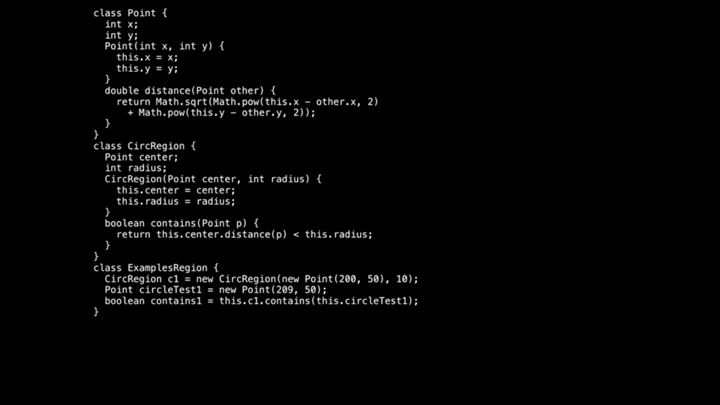

Slide 7
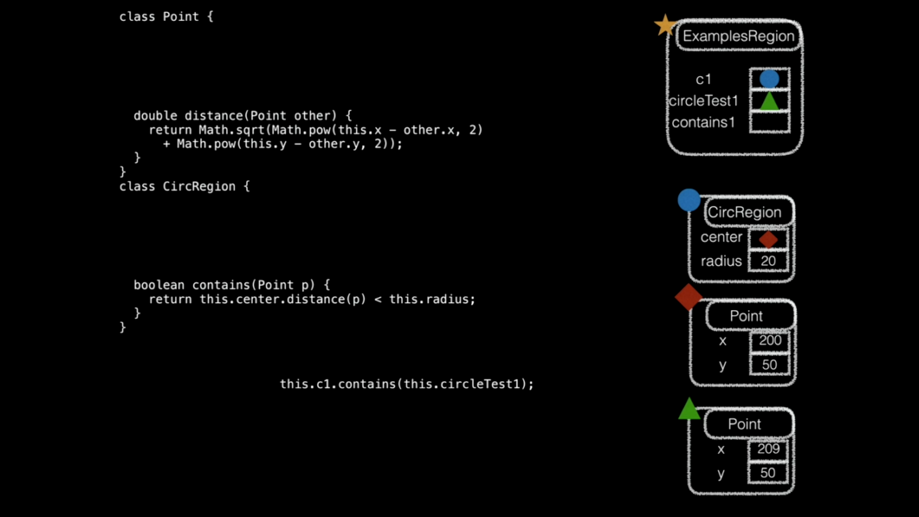

Slide 8
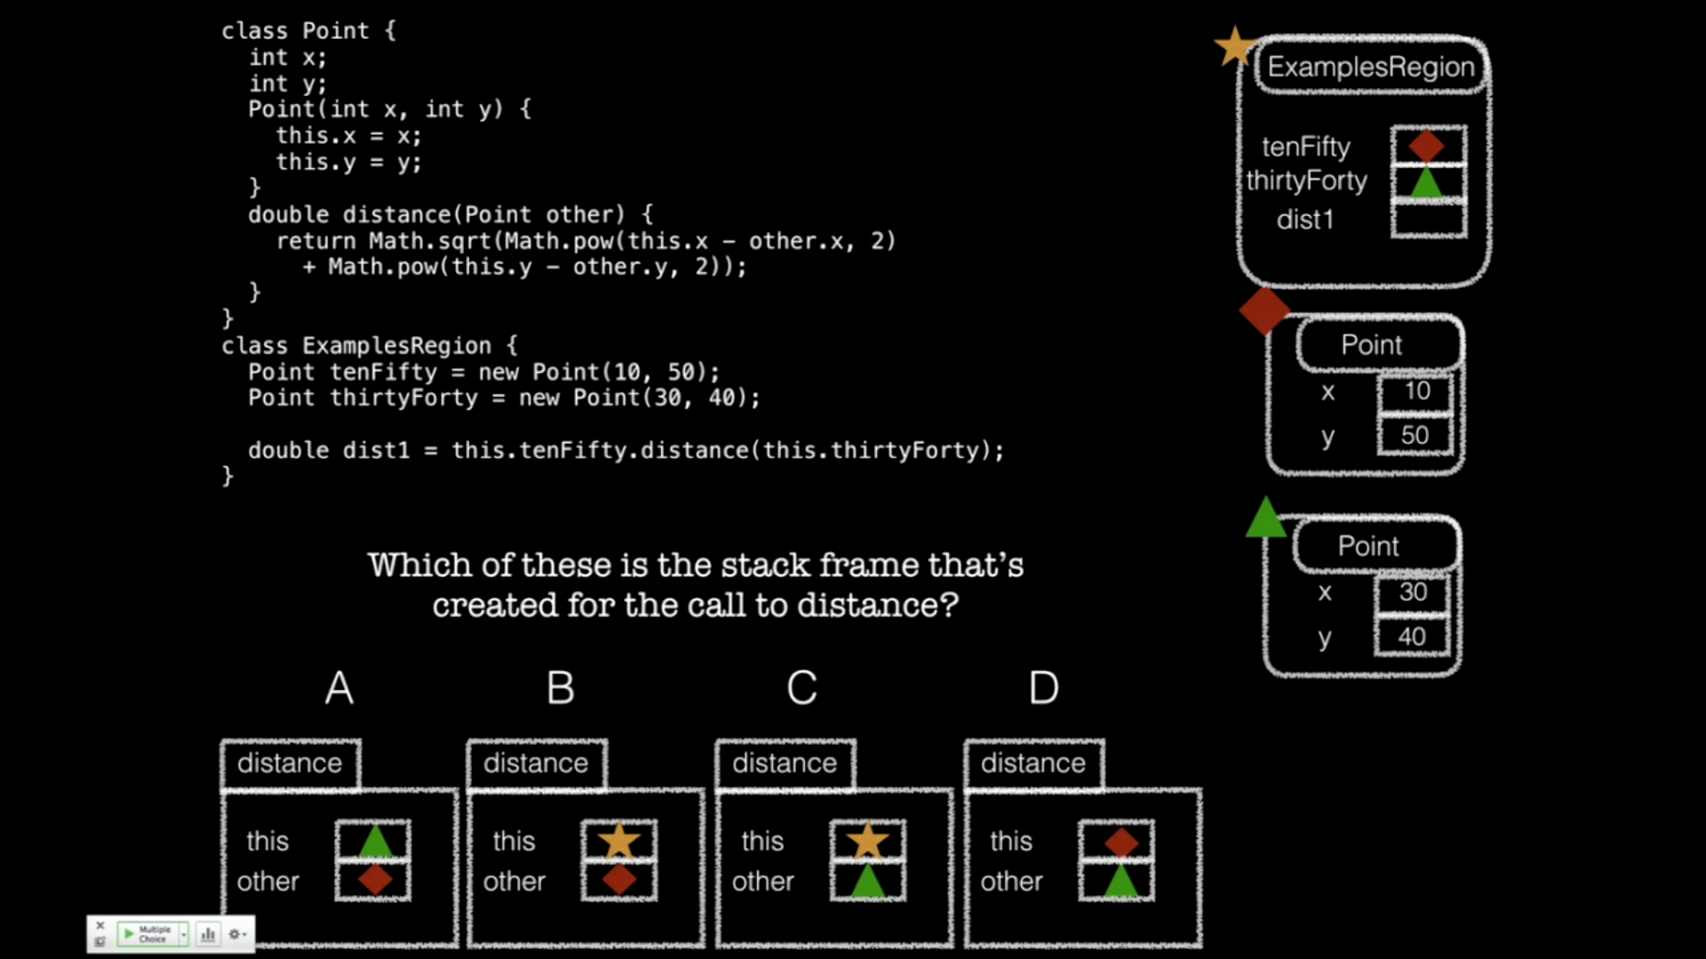


Slide 9
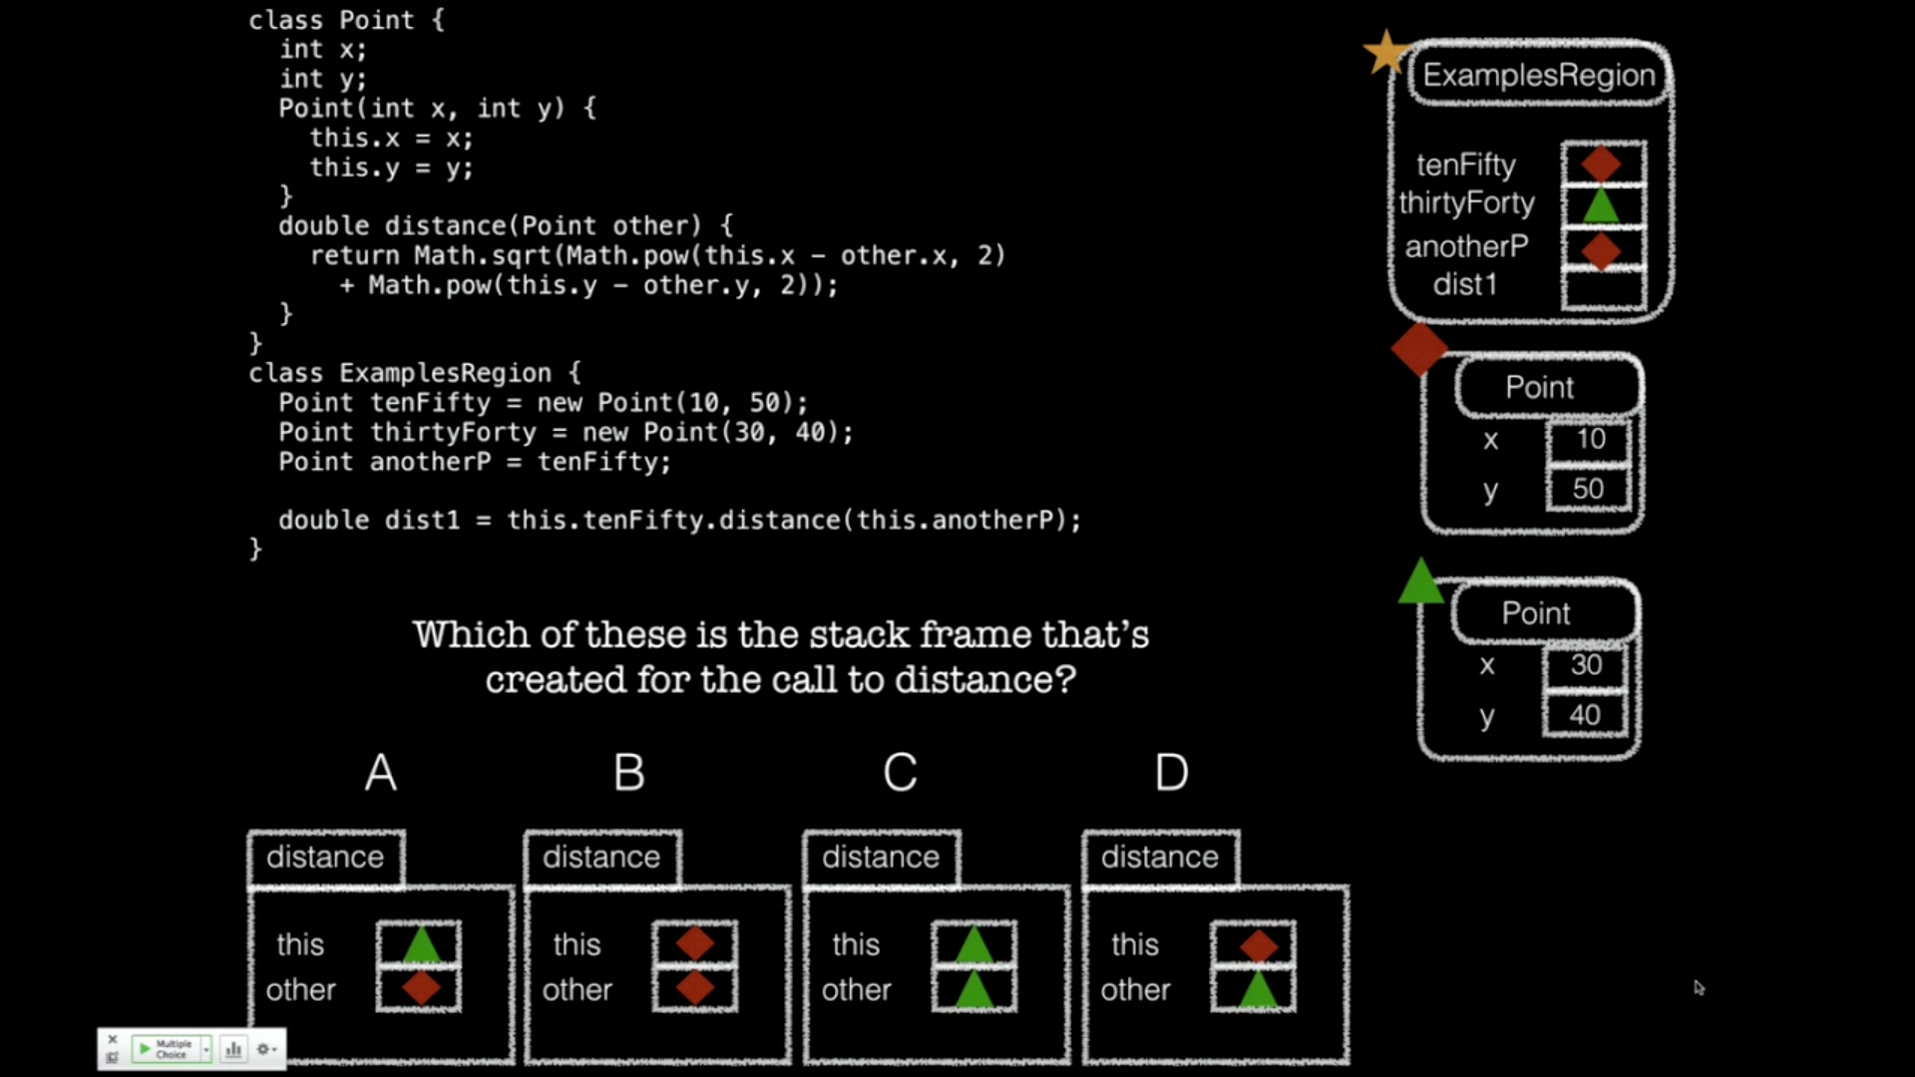



Slide 10
Constructors
Now that we understand the Stack, we have what we need to understand constructors

Slide 11
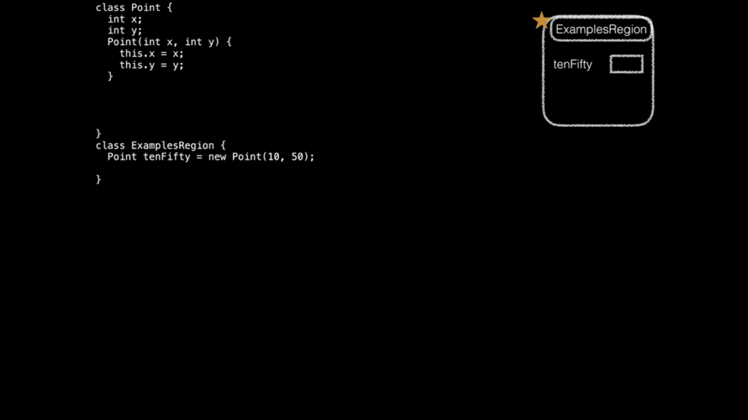

Slide 12
Constructor Summary
Constructors:
Are special methods, called when new is used
Are passed the newly-constructor object as this, and any arguments
Typically assign values into fields using this.field = value
When new is used:
A fresh object, with a new reference is created with uninitialized fields
The constructor with parameters that match the arguments is called
The whole new expression evaluates to the new reference

Slide 13
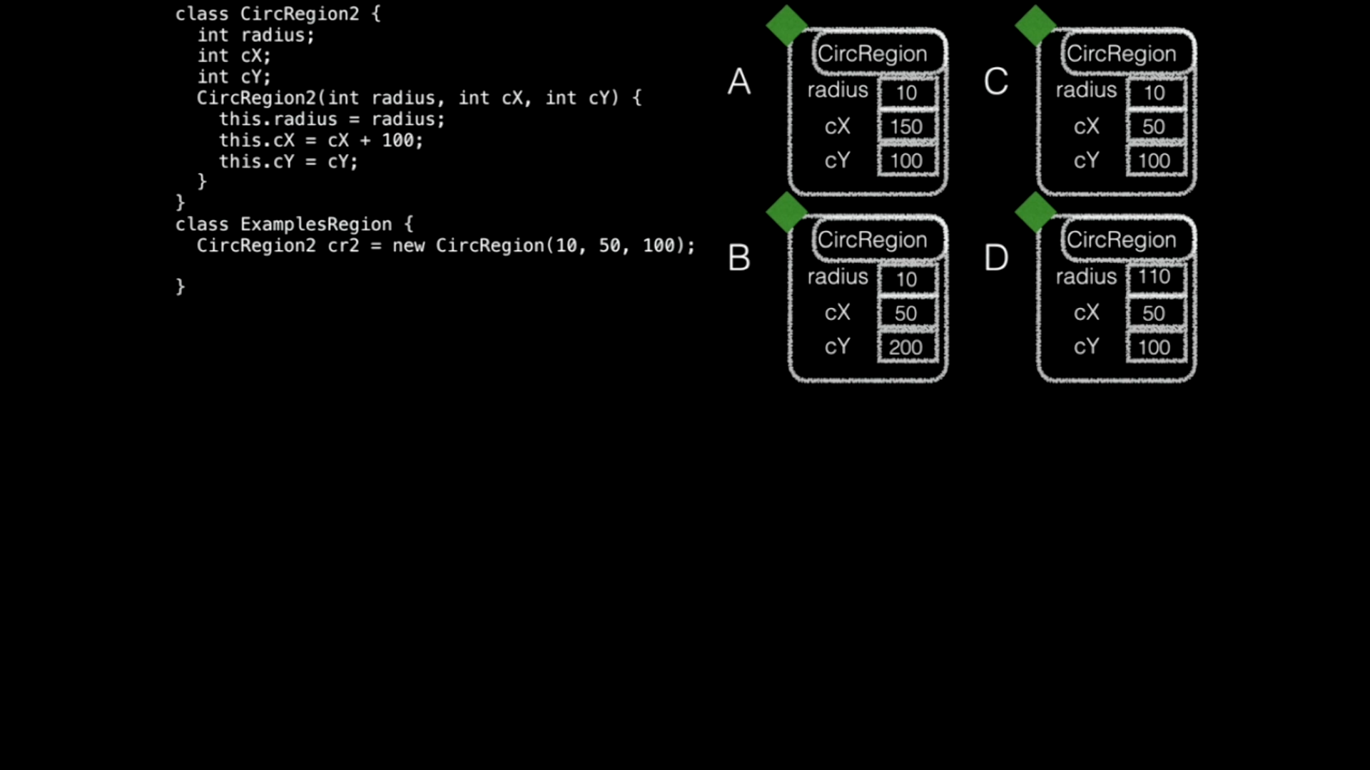

Slide 14
